Slide 1
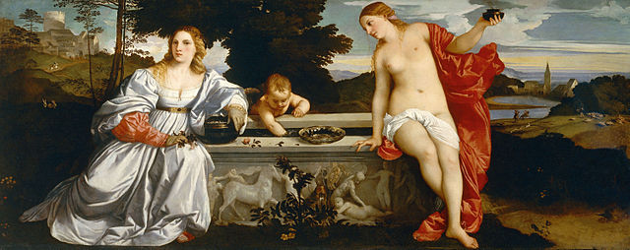
History 336
Ideas and Society in Early Modern Europe:
The Debate about Gender and Identity

Slide 2
Questions for 27 February
What passages strike you as historically significant in Marinella’s book?
How does Marinella’s writing about women resemble and differ from Vives’ strategies and message? Consider the entire assigned reading but also in particular pp. 93-104.
How convincing is Marinella’s case for the superiority of women? Consider chapters 3 and 4.
Why does Marinella often mention and quote Aristotle? Consider pp. 51, 72-73, 79, 93, 105, 107, 115.

Slide 3
Questions for 27 February
Remember what Joan Scott says about gender: “gender is a constitutive element of social relationships based on perceived differences between the sexes.” What can we say about Marinella’s thinking about gender? Consider what she says about “men’s poetry” (p. 63) and male historians (p. 81) in light of her general presentation of women. Consider also how she expresses women’s superiority to men on pp. 45, 51, 53, 55, 62, 68, 69-70.

Slide 4
Questions to consider for the rest of the course
What passages strike you as historically significant? Mark them and write them down.
What positions on women and gender does a given primary source take on women and gender? How does the author support these positions?
Can you formulate at least one historical question based on the assigned reading to start a larger discussion?
Can you find a few secondary sources (and other primary sources) by using the library catalogue and databases that will help you answer your historical question?
Can you think of any current news stories that relate to women and gender?

